Slide 1
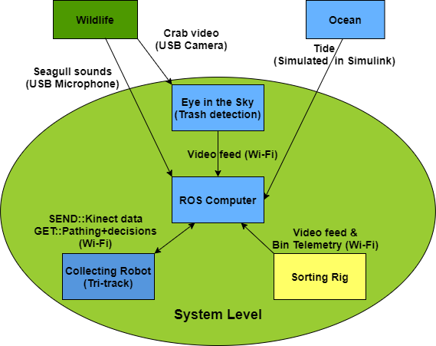

19WSD001 Team Project – E.A.R.T.H
18/03/2020
Objectives/ Aim (What?)
Aim: Accurately identify and sort rubbish from a beach,
leaving it in a higher standard than when arriving.
Current Objectives (from highest to lowest priority)
Grabbing trash by tri-track bucket
Sorting trash by sorting rig
Trash pickup order prioritization by tri-track
Prioritizing trash at the boundary of the waterline
Activities (How)
Budget statement
Remaining Budget: ~ £ 165
Spent: ~ £ 335
Budget Plan please see link: https://bit.ly/2ZYQfXB
Actions | State
Pathing – map of environment Pathing – decision of route to destination Pathing – decision of efficient order to collect trash
Bin detection
Identifying trash – Object recognition Sorting trash – Grabbing object Sorting trash – Placing in appropriate bin
Detecting, categorizing & avoiding crabs
Wildlife(seagull) detection & alerting user
Attempting to get trash at the waterline boundary
Integration between ROS system & sorting rig
Telemetry – UI Design Telemetry – Data acquisition & Camera feed Telemetry – Camera feed
Mission phase completion
Phase | Completion & autonomy
Enter and navigate the beach area using intelligent route finding​ | 2
Identify recycling bins from optically coded sensors (at least 3 different types) | 3
Identify and sort different types of rubbish | 3
Identify and characterize different crab types and the routes taken​ | 3
Actively avoid interfering with the crabs​ | 4
Identify and alert operators about other wildlife | 4
Identify waterline and actively avoid or mitigate against the incoming tide​ | 1
Stakeholders (Who?)
Stakeholders for student product:
Team members, PST and Loughborough University
Companies and others interested in Open-Day
Stakeholders for final product (real-world application):
System operators, beach-cleanup company and suppliers
People and wildlife on the beach
Beach management, staff & shareholders
Recycling businesses
Strategy/ Plan (Why?)
Integrate different implemented modules of the system using ROS
Minimize unnecessary complexity to the system while maintaining functionality
Agile testing approach while making changes to improve robustness
Currently working on: Finishing and integrating systems
Overall Target: Level 3 – Conditional Automation
Key issues and risks
Medium risk & high impact:
Infection due to Coronavirus outbreak [Take appropriate safety precautions]
Supply chain compromised due to deadline and Covid-19 [Hardware failures mitigated by PST & team’s contingency stock]
Logistics of team members for integration over Easter break [Tasks will be assigned beforehand to combat system constraints]
Team information
E.A.R.T.H Github:
https://github.com/orgs/lboroWMEME-19WSD001/teams/e-a-r-t-h
E-portfolio:
https://teamearth1.wordpress.com/
Programme
Semester 1 End
Easter
Gateway 1 (S1W4)
Gateway 2 (S1W12)
Gateway 3 (S2W7)
VIVA (S2W10)
Key
Completed
In progress
Not Started
Key
Notes:
A version of this is compulsory at each gateway meeting and optional for PST meetings.
In terms of sizing, this should be legible printed on A3, but will probably be viewed on screen. Minimum font size =12
Diagram in the middle should be a top level systems diagram.
The plan will change as the project progresses – that is ok and expected.

